Slide 1
Stroke Prediction Model Using R
A Machine Learning Approach for Early Stroke Detection

Slide 2
Overview
This project involves developing a stroke prediction model using machine learning techniques in R.
Key techniques include data preprocessing, exploratory data analysis, model training, and evaluation.

Slide 3
Methods Used
1. Data Cleaning & Preprocessing: Handled missing values, encoded categorical variables.
2. Exploratory Data Analysis (EDA): Identified key stroke risk factors.
3. Model Training: Logistic Regression, Decision Tree, Random Forest, XGBoost.
4. Model Evaluation: Accuracy, Precision, Recall, F1-score.
5. Future Considerations: Deployment via RShiny API.

Slide 4
Key Findings
• XGBoost achieved the highest accuracy (94.6%).
• Age, BMI, and glucose levels are strong predictors.
• Class imbalance impacts model performance; consider SMOTE balancing.

Slide 5
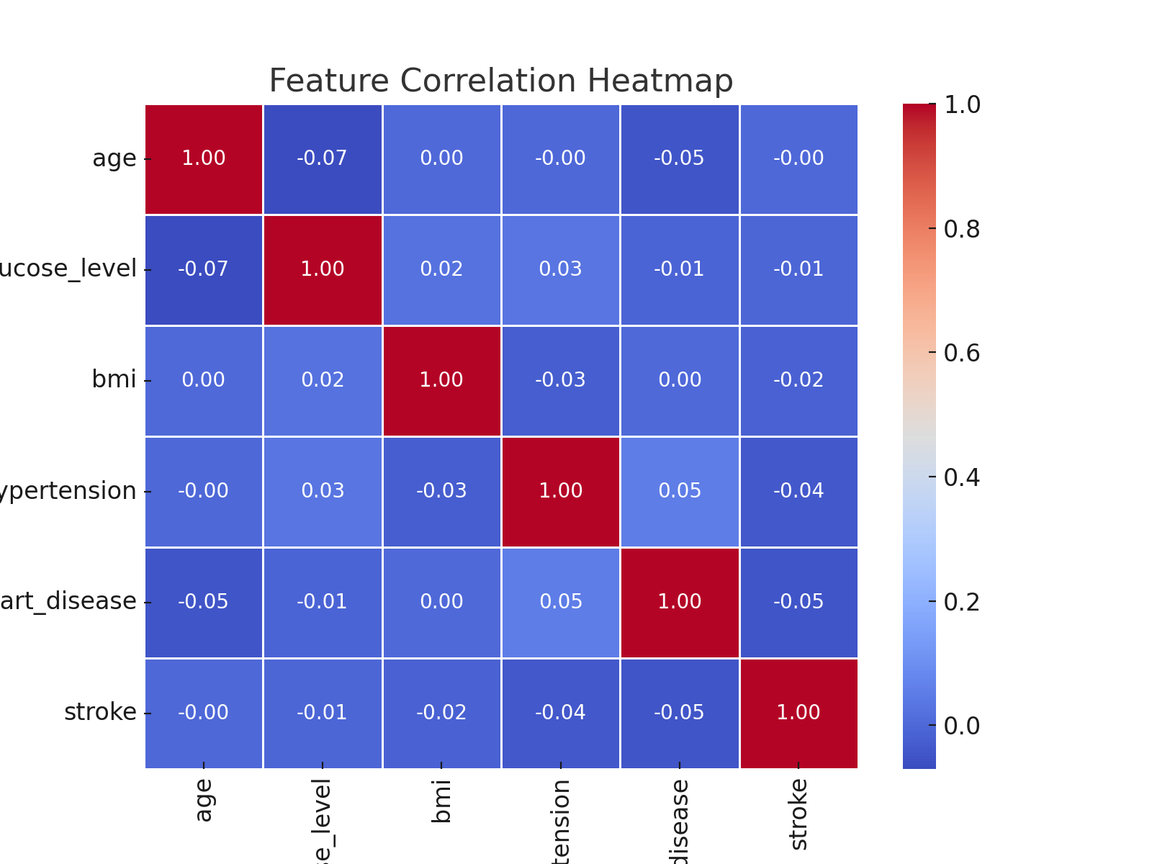
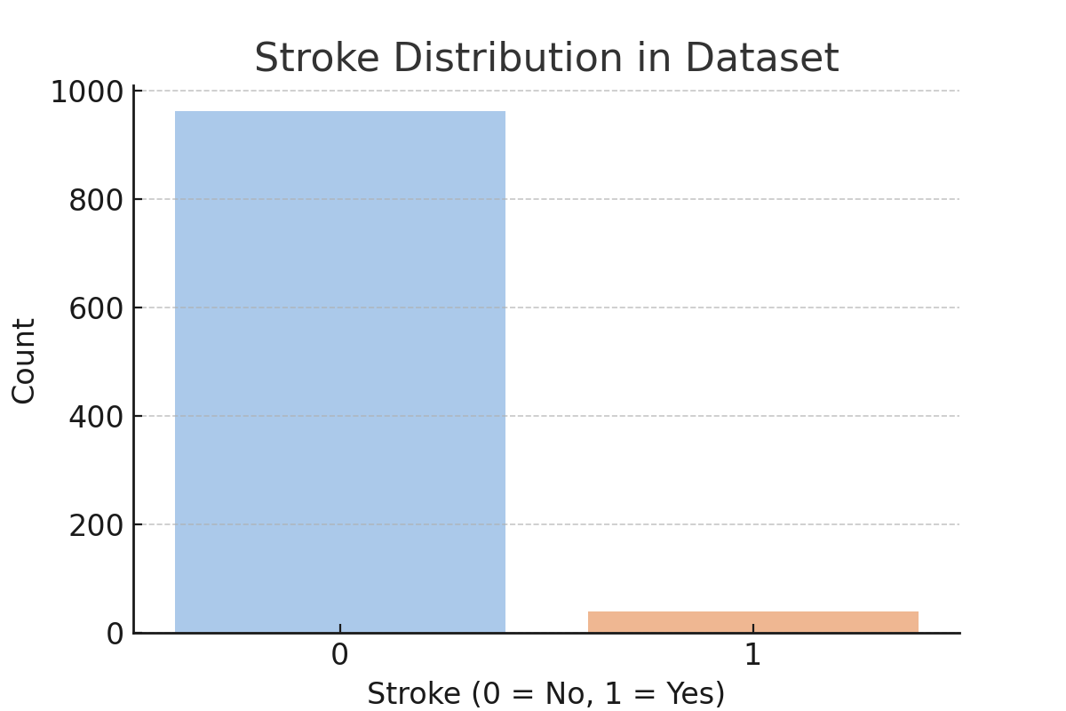
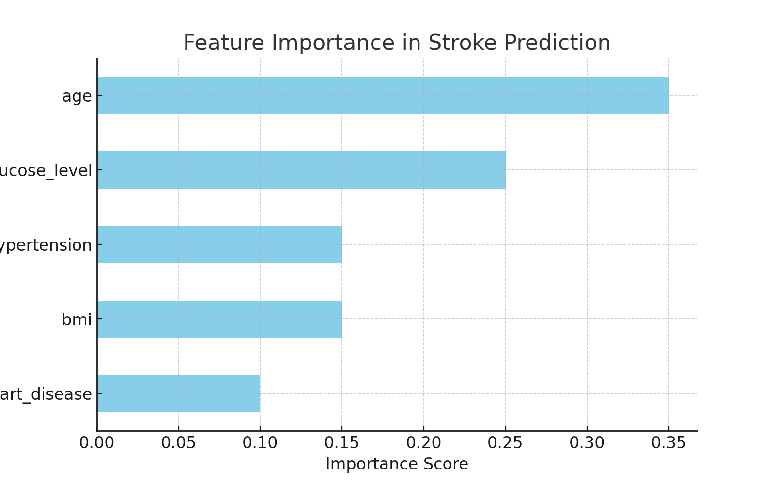
Visualizations

Slide 6
Conclusion
The stroke prediction model provides a reliable tool for early detection.
Next steps include hyperparameter tuning, class balancing, and real-time deployment.

